Slide 1
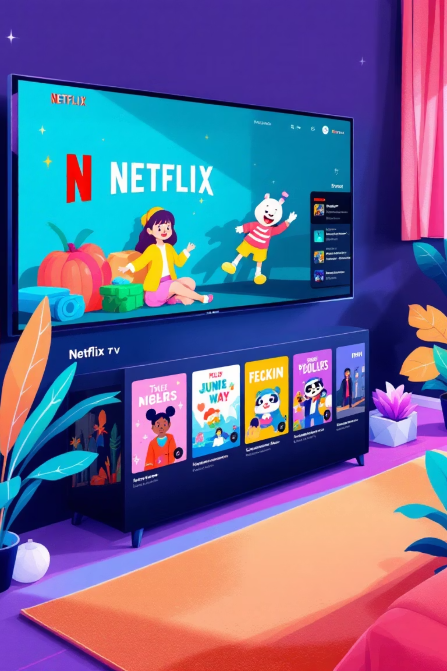
NETFLIX EXPLORATORY DATA ANALYSIS
“A comprehensive exploration and visualization of Netflix data to uncover key patterns, emerging trends, and user viewing preferences across the platform.”
NAME – ANKIT RAJ
GUIDE –MISS NAINA DEVI
TECHNO INDIA UNIVERSITY
| B.TECH 3rd YEAR

Slide 2
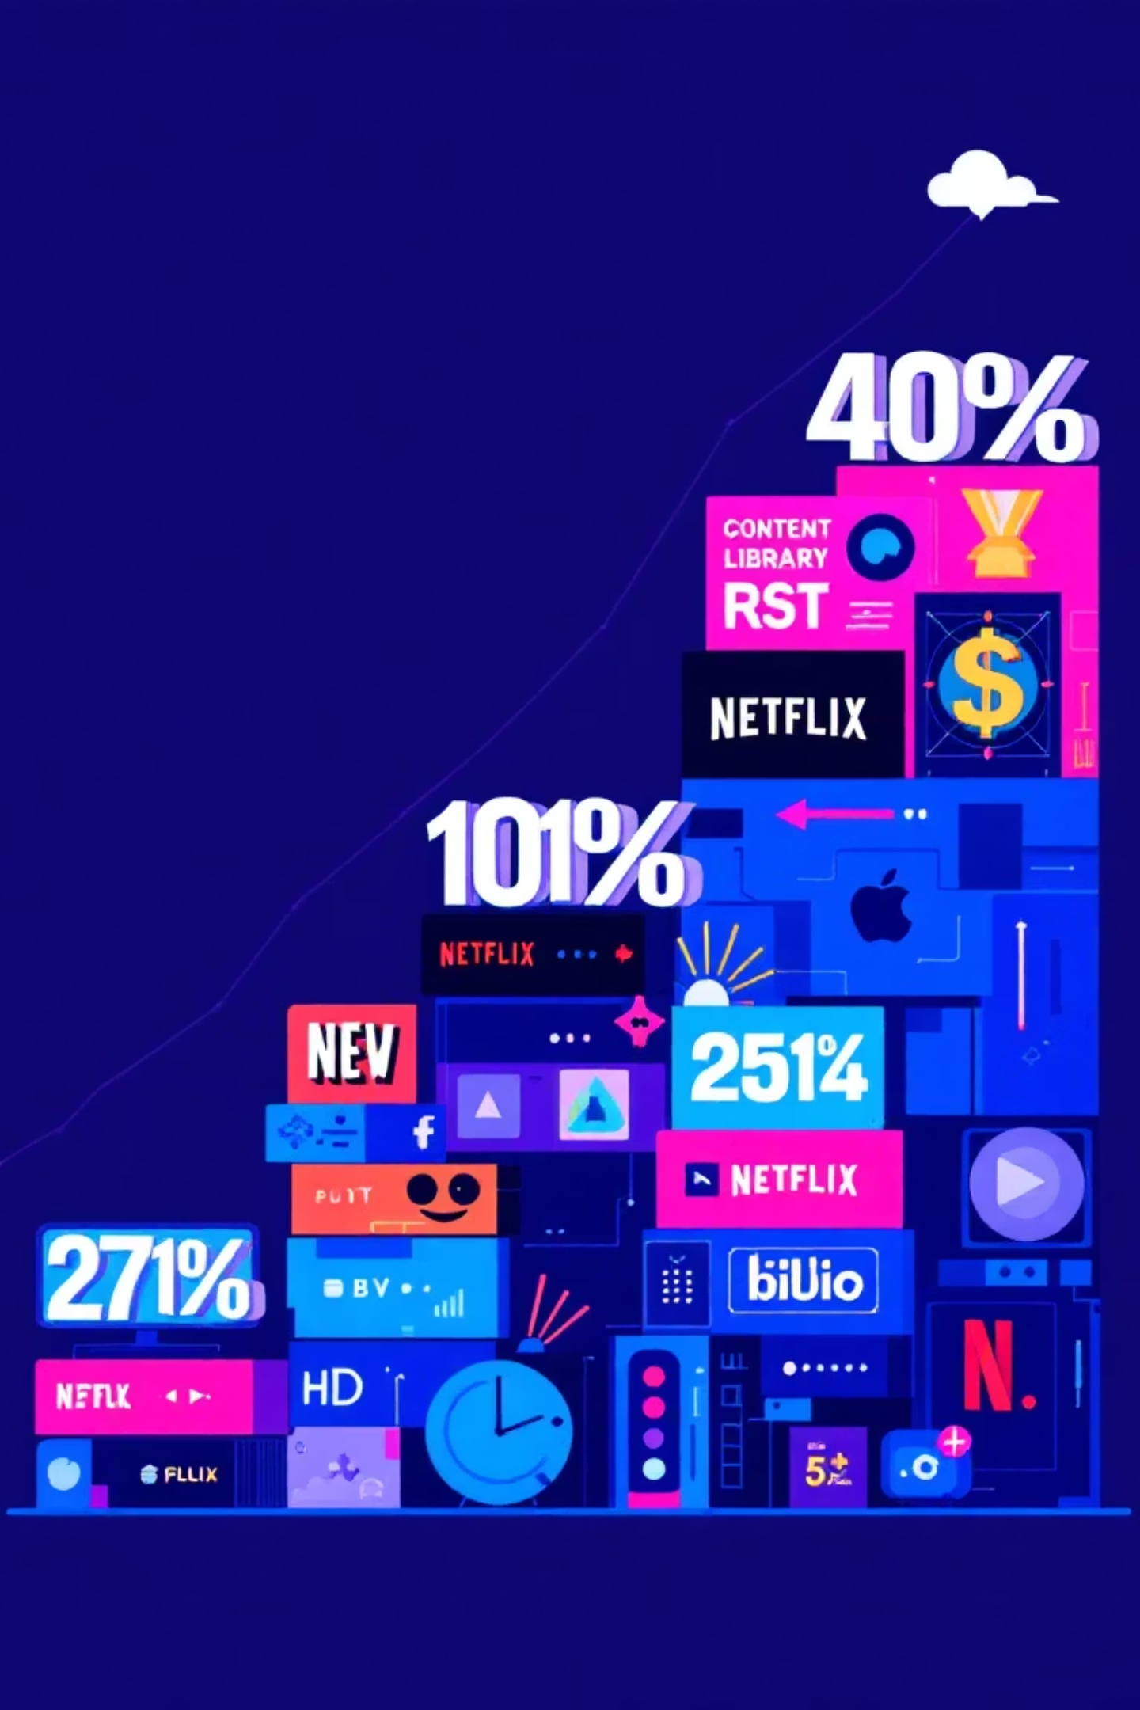
AGENDA
Introduction to the Dataset
Objectives of the Analysis
Understanding Data Attributes
Data Cleaning & Preprocessing
Exploratory Data Analysis
Content distribution (Movies vs TV Shows)
Year-wise trends
Country-wise analysis
Genre-wise insights
Rating classification analysis
Visualization of Key Insights
Correlation & Patterns Observation
Findings & Insights Summary
Conclusion
Future Scope

Slide 3

Introduction to the Dataset
Mission
Why It Matters
Transform raw Netflix data into actionable insights by cleaning, analyzing, and visualizing streaming patterns, content diversity, and user interactions to understand audience preferences and content performance.
This analysis provides strategic intelligence for content creators, platform strategists, and product teams—revealing what audiences watch, when they watch it, and how they engage with streaming content.

Slide 4
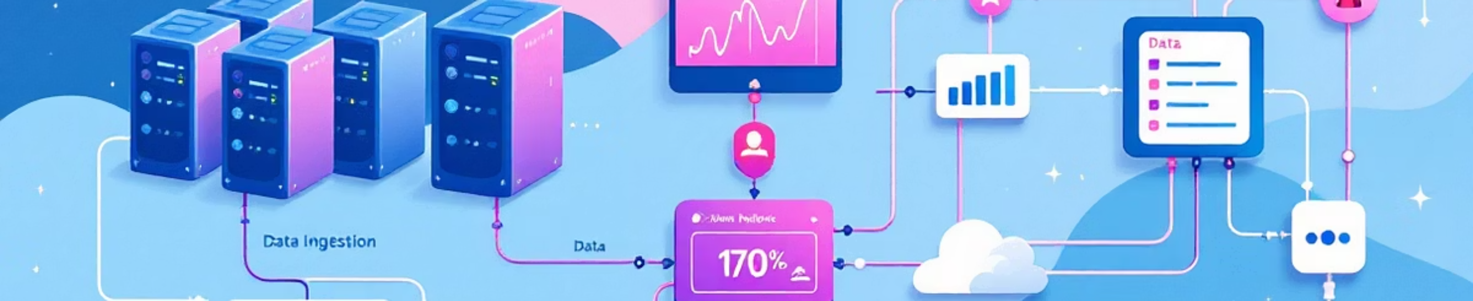
Understanding Data Attributes
Raw Dataset
Processing Tools
Comprehensive Netflix data including content metadata, user reviews, ratings, and interaction history sourced from the Raw Data directory.
Python ecosystem: Pandas for data manipulation, NumPy for numerical operations, Matplotlib and Seaborn for advanced visualization.

Slide 5

Data Cleaning & Preparation
1
Rigorous Data Integrity
2
Handle Missing Values
3
Unnest Comma-Separated Data
Systematically identified and resolved data quality issues, removed duplicates, and standardized formats across all fields.
Applied sophisticated imputation strategies and documented handling approaches to maintain analytical reliability.
Deconstructed nested columns containing multiple genres, actors, and directors into granular, analyzable records for deeper exploration.

Slide 6
Exploratory Data Analysis
Content Diversity
Temporal Patterns
Movies vs. TV shows distribution
Release date trends over decades
Genre landscape and categorization patterns
Peak production periods and seasonal variations
Content production trends across regions
Content acquisition velocity and platform growth

Slide 7

User Engagement & Preferences
Rating Distributions
Genre Preferences
Analyzed user ratings to identify sentiment trends and quality perception across content categories.
Discovered dominant genres and viewing patterns that reveal audience interests and platform content strategy priorities.
Viewer Behavior
Popularity Signals
Explored how users interact with content, identifying key drivers of engagement and content consumption patterns.
Tracked rising stars among actors, directors, and content types that influence audience decisions.

Slide 8
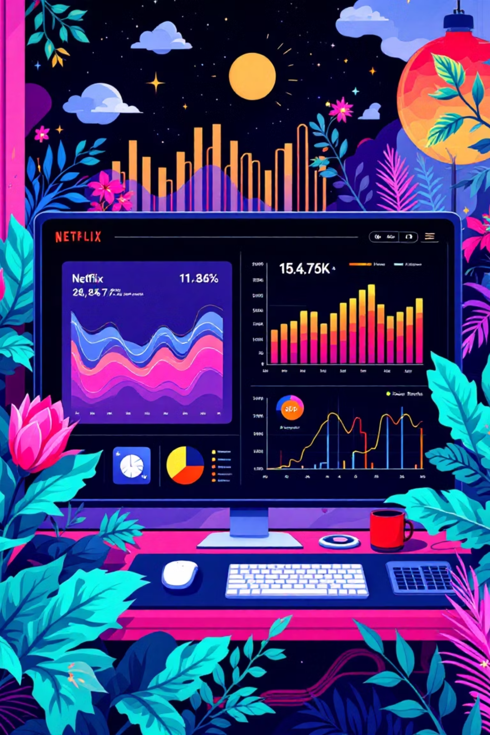
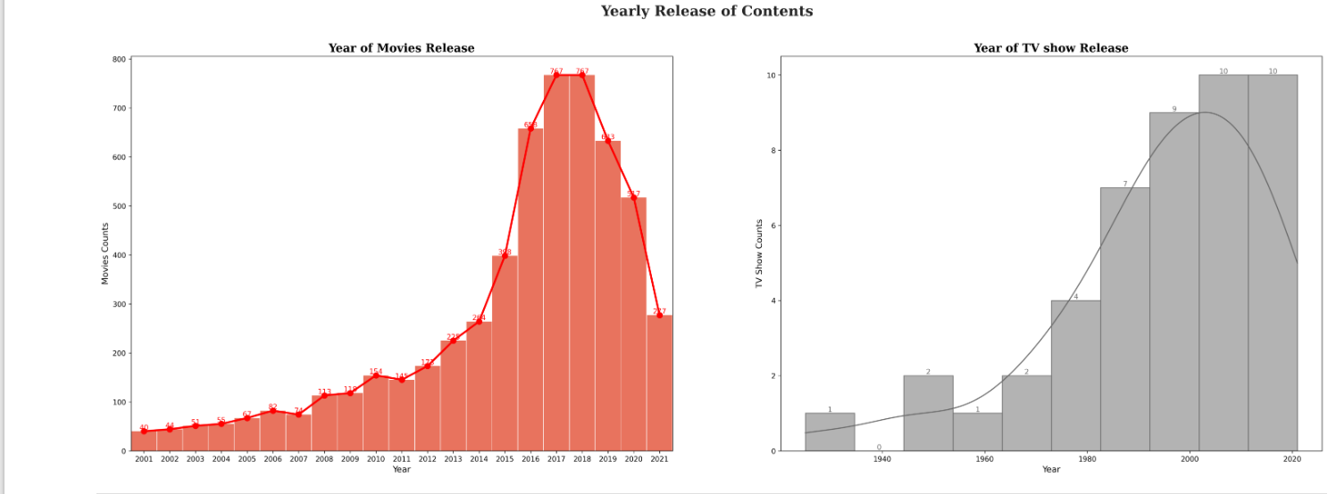
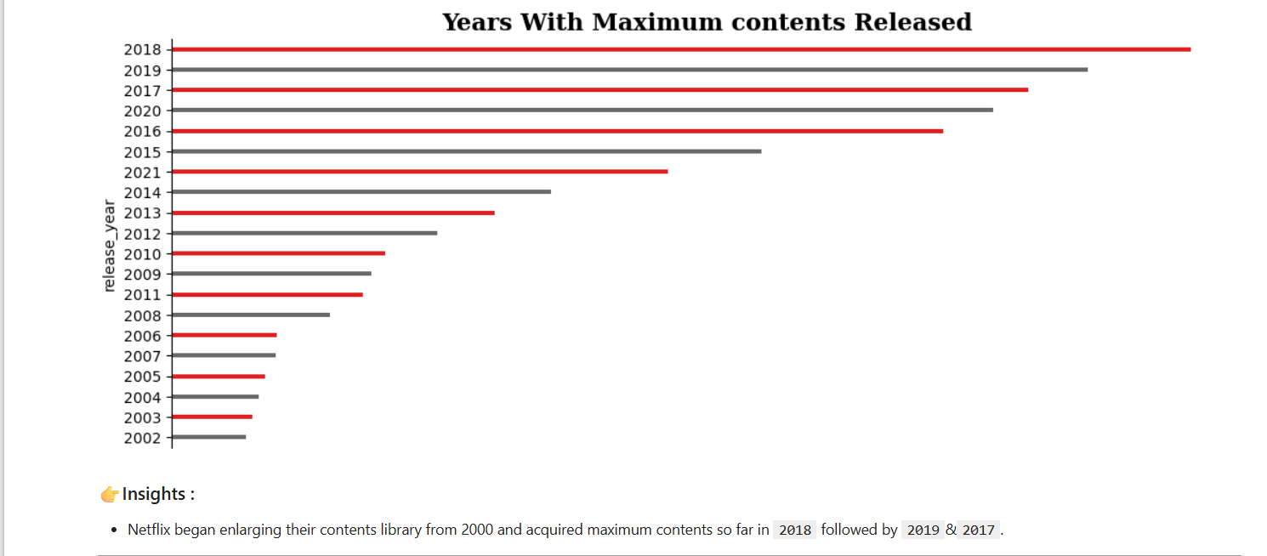
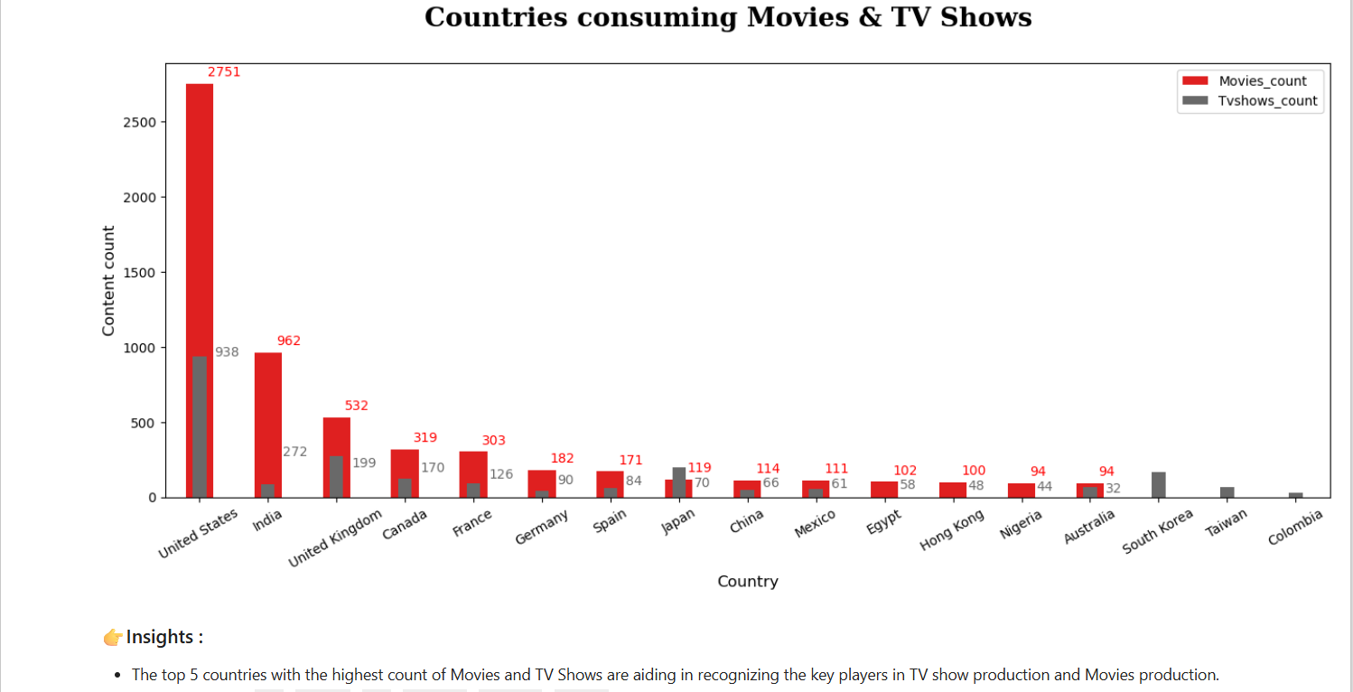
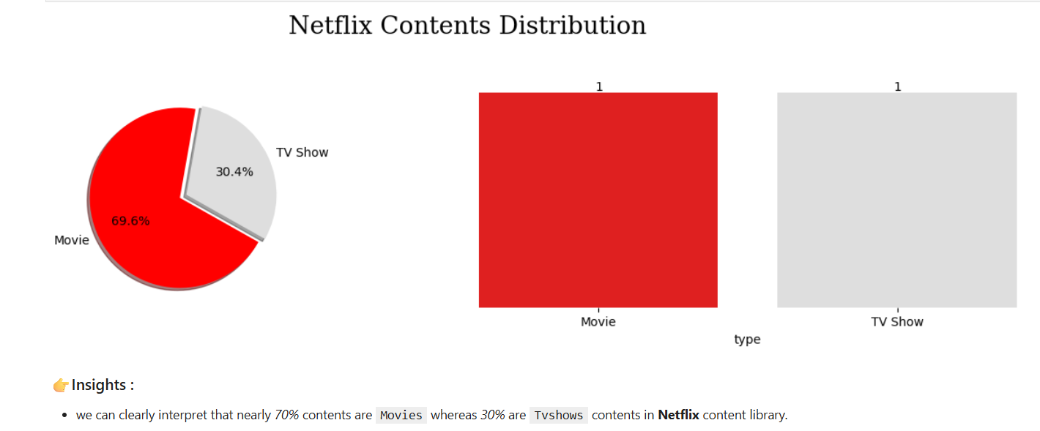
Visualizations & Insights
Advanced visual analysis reveals temporal trends in content releases, genre clustering patterns, and rating distributions that inform strategic decisions for content acquisition and audience targeting.

Slide 9
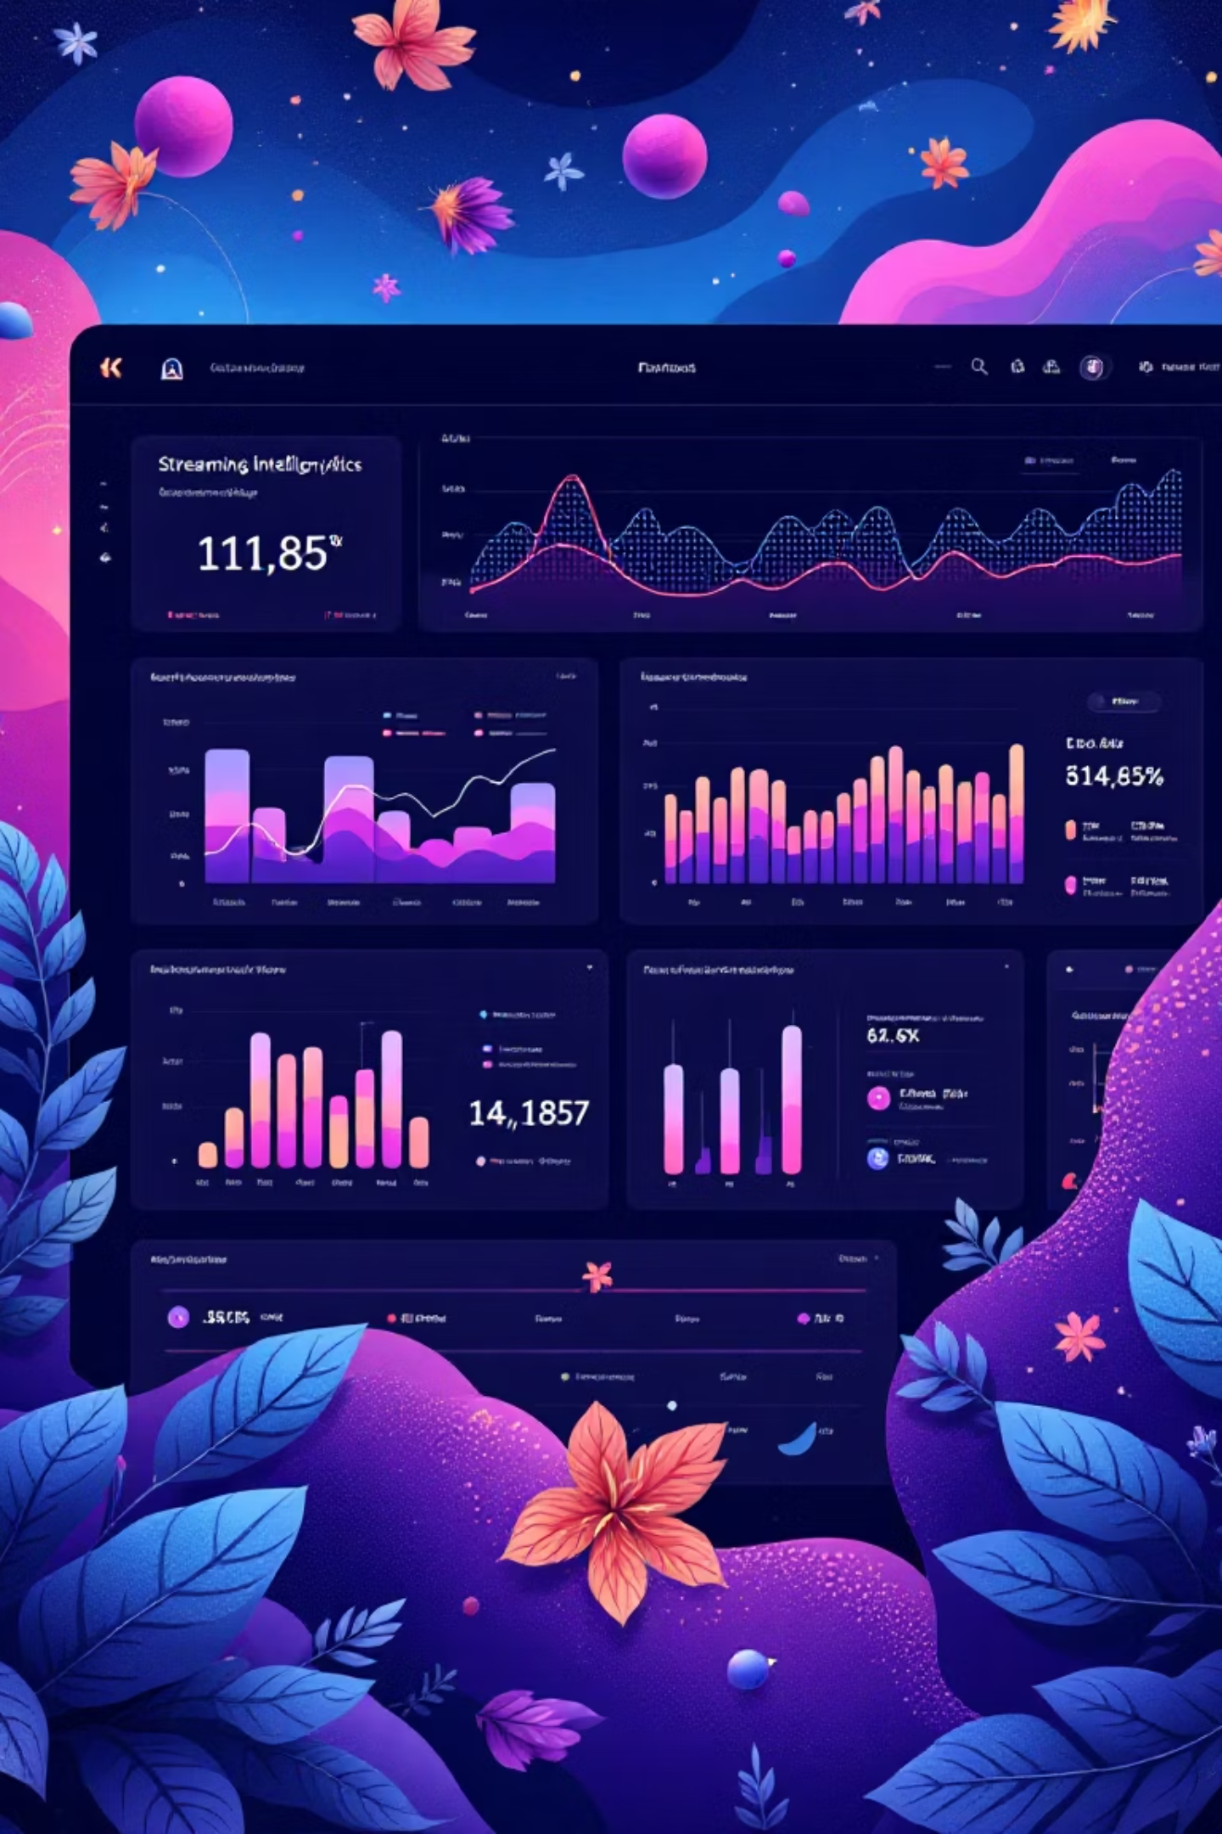
Strategic Impact
For Content Creators
For Platform Strategists
For Product Teams
Data-driven insights into what audiences want, optimal release timing, and genre trends inform production decisions and content pitching strategies.
Actionable intelligence on content acquisition priorities, audience segmentation, and engagement levers to optimize subscriber growth and retention.
User behavior patterns and preference data enable feature development, personalization algorithms, and recommendation system refinement.

Slide 10
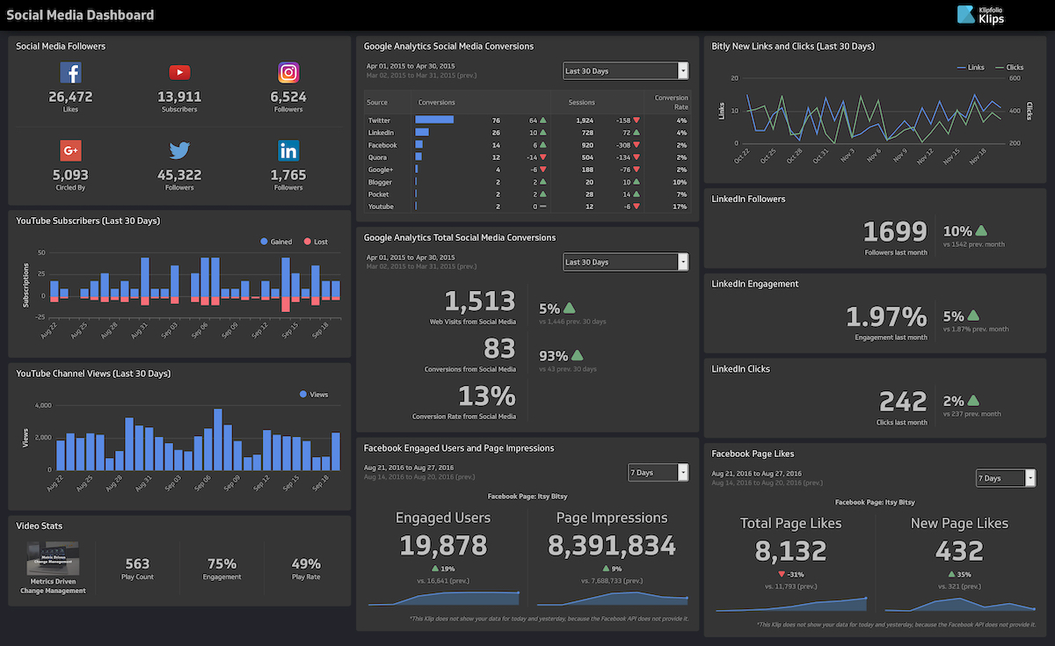
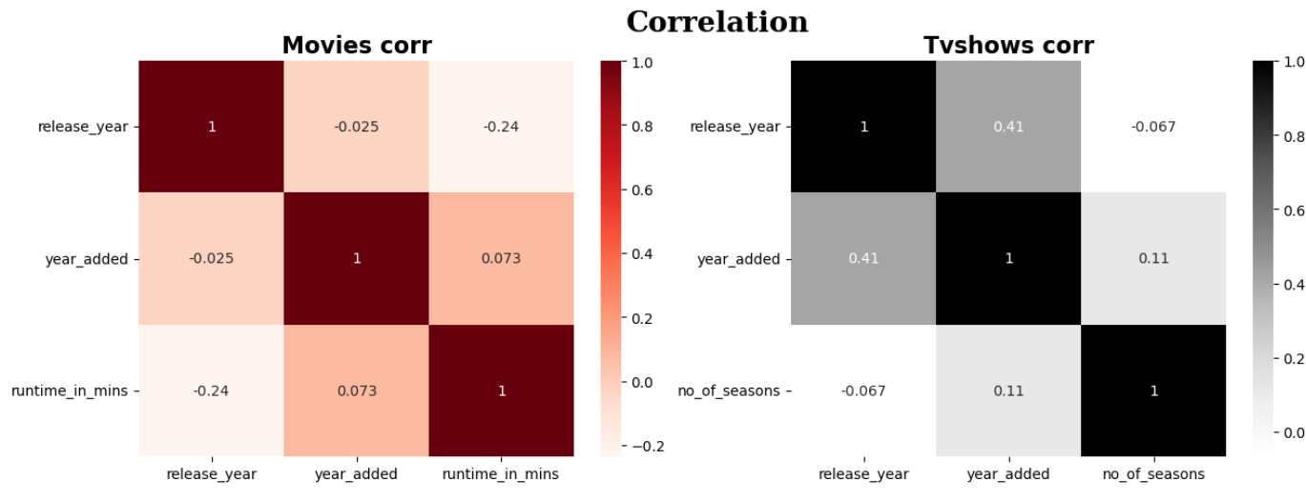
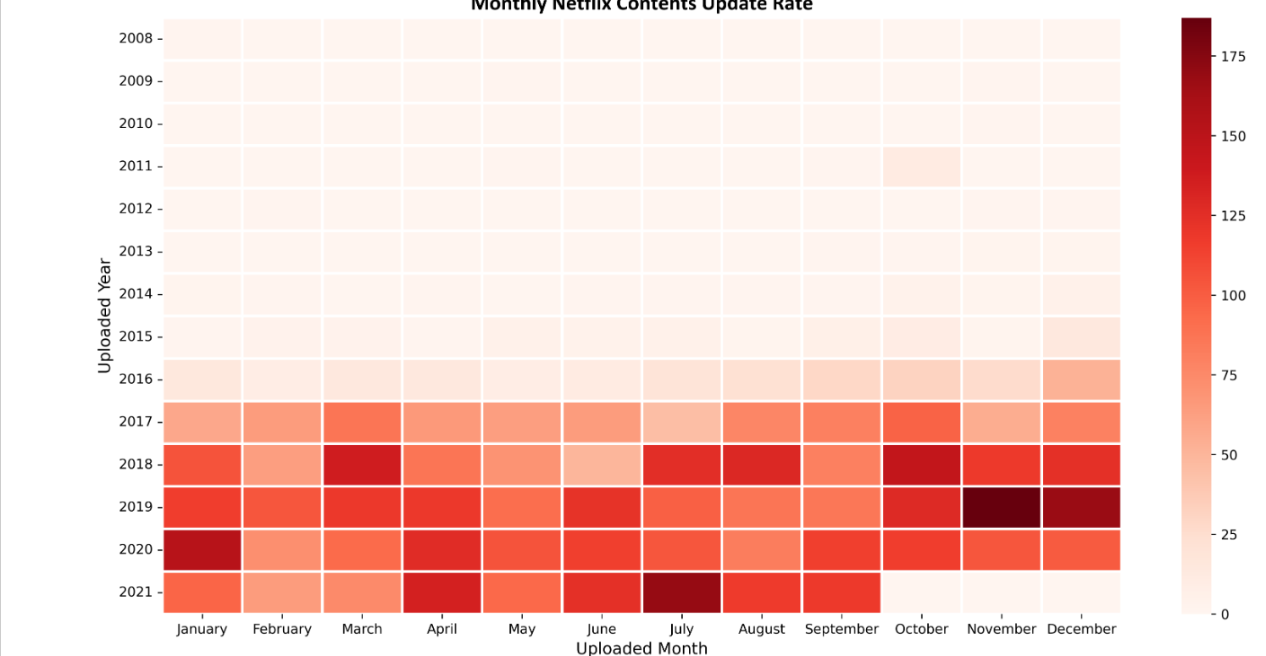
Correlation &
Patterns Observation
On Netflix, Movies outnumber TV Shows in overall count.
The highest number of title additions occurred during the 2016–2020 period.
Year Added shows a weak positive relationship with Release Year.
Movie durations mostly fall between 80–120 minutes, while TV shows generally have 1–2 seasons.
The most common rating categories are TV-MA, TV-14, and TV-PG.
The USA is the top content producer, with India and the UK also being major contributors.
Dominant genres include Drama, International Movies, and Comedies.
This Photo by Unknown Author is licensed under CC BY-SA-NC

Slide 11
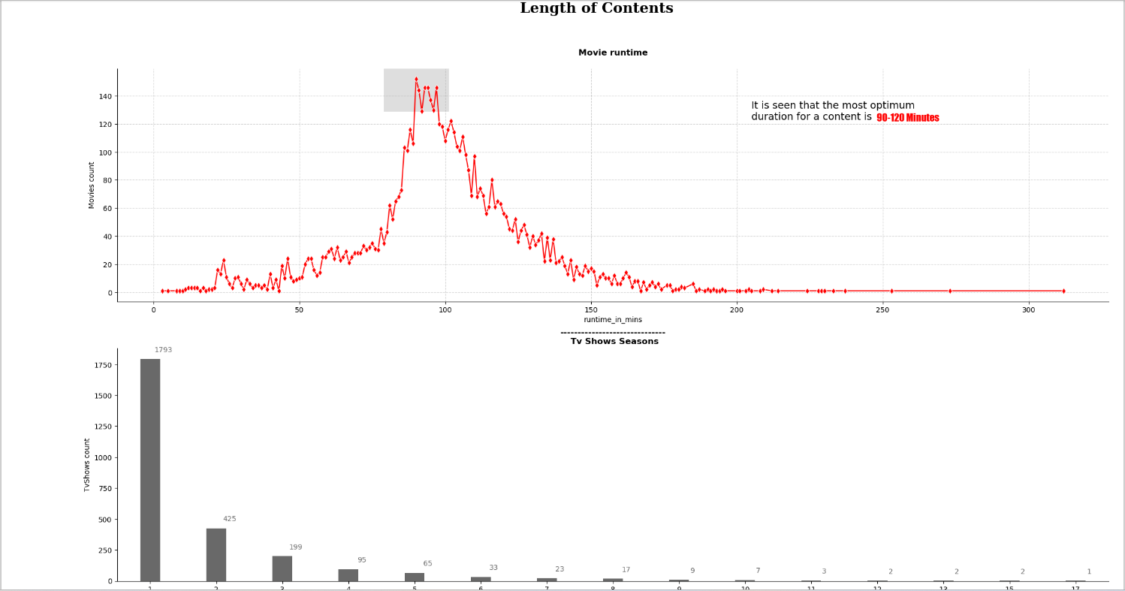
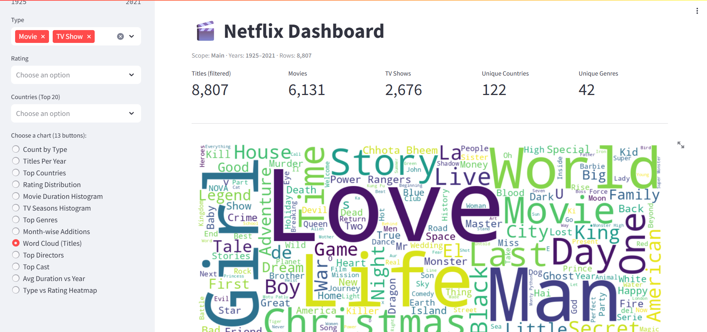
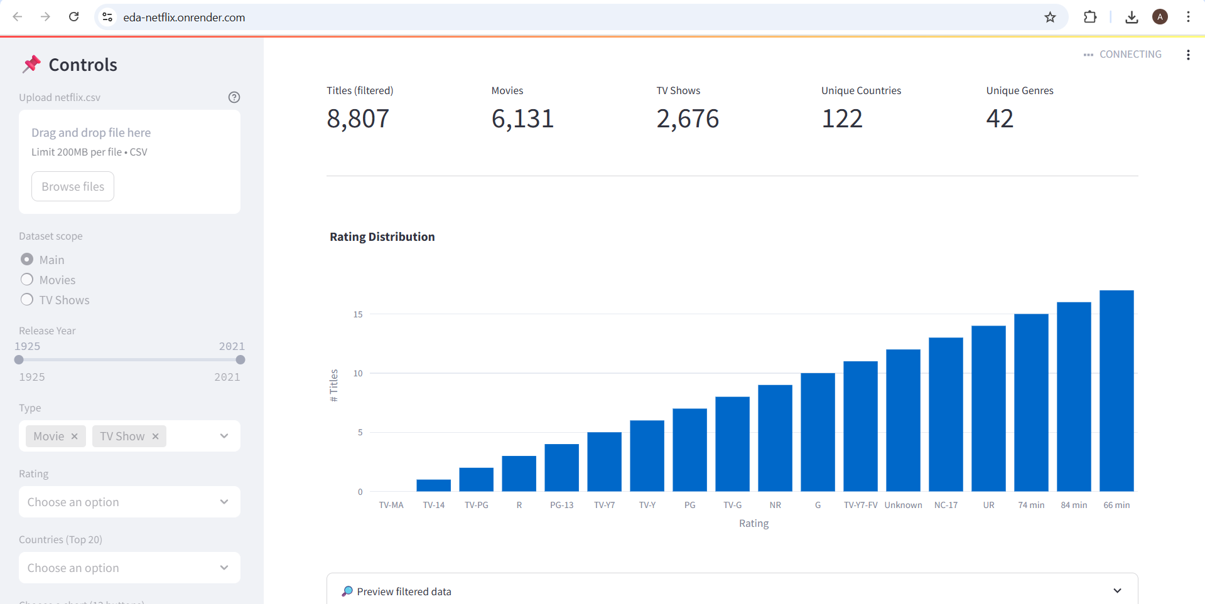
Findings & Insights Summary
Movies dominate the Netflix catalogue compared to TV Shows.
Most content additions occurred between 2016–2020.
Netflix prefers adding recently released titles to its platform.
Content trends show short-duration movies and 1–2 season TV shows are most common.
TV-MA and TV-14 are the most frequent rating categories.
The USA is the largest content producer, with India and the UK emerging strongly.
Drama, International Movies, and Comedies are the top performing genres.

Slide 12
Findings & Insights Summary
Content Type Insights
Genre Dynamics
Movies dominate Netflix's library, but TV series drive recurring engagement and subscriber retention through episodic release strategies.
Drama and international content show explosive growth, reflecting Netflix's strategic pivot toward global audiences and diverse storytelling.
Rating Correlations
Creator Influence
Strong correlations exist between production budget, release year, and user ratings, suggesting quality perception tied to production values.
Top-tier directors and actors significantly impact viewership rates, making talent acquisition a critical content strategy component.

Slide 13
CONCLUSION:
The Netflix dataset reveals a strong preference for movies, recent releases, and short-format content. Most additions occurred between 2016–2020, showing a period of rapid platform expansion. The USA leads in content contribution, while India and the UK are emerging markets. Popular genres and ratings indicate that Netflix focuses heavily on diverse global audiences, offering a mix of mature, international, and drama-based content. Overall, the platform emphasizes fresh, high-demand titles tailored to varied viewer preferences.
NAME – ANKIT RAJ
GUIDE – MISS NAINA DEVI

Slide 14
WORKING WEBSITE
The Netflix website offers a smooth, user-friendly interface that makes it easy for viewers to explore movies and TV shows.
WEBSITE LINK - https://eda-netflix.onrender.com
GIT HUB - https://github.com/ankit79039-source/EDA-NETFLIX.git

Slide 15
Future Scope:-
Extend analysis using machine learning to predict content popularity.
Include IMDb ratings and viewer engagement data for deeper insights.
Create an interactive dashboard using Power BI or Tableau.
Automate updates with Netflix’s latest data through APIs.

Slide 16

NAME- ANKIT RAJ

